Slide 1
Gapminder
Data Analysis
Vjollca Kastrati, Nicole Mackin, Brooke Zimmer, Ariel Bacuilima

Slide 2
Question 1: How many adults in the world say they can read?
We looked at this question and used the data sets regarding Literacy Rates in adults and GDP per capita. We specifically focused on the data for the year 2011. Our analysis of the data made it clear that a higher literacy rate was linked with a higher GDP per capita. This indicated that countries with a higher income and a stronger economy have more access to an education than countries with a weaker economy.

Slide 3
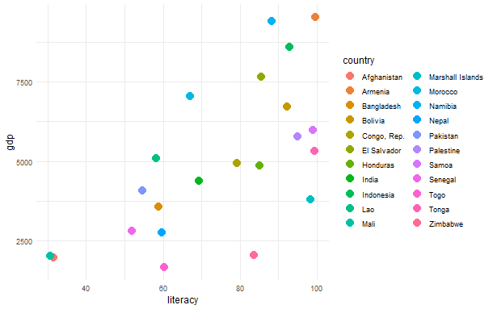

Slide 4
library(dplyr) library(ggplot2) #Q1: How many adults in the world say they can read? # this question peaked a curiosity to find out if literacy rate correlated with # GDP per capita across different countries? #please download datasets # Read in the datasets literacy <- read.csv("literacy_rate_adult_total_percent_of_people_ages_15_and_above.csv") gdp_per_capita <- read.csv("gdp_pcap.csv") # Filter the datasets to include only the year 2011 literacy_2011 <- literacy[, c("country", "X2011")] gdp_per_capita_2011 <- gdp_per_capita[, c("country", "X2011")] # Merge the 2 datasets by country literacy_gdp <- merge(literacy_2011, gdp_per_capita_2011, by = "country") # Rename columns colnames(literacy_gdp) <- c('country', 'literacy', 'gdp') # Convert 'literacy' and 'gdp' columns to numeric literacy_gdp$literacy <- as.numeric(literacy_gdp$literacy) literacy_gdp$gdp <- as.numeric(literacy_gdp$gdp) # Remove missing values if any literacy_gdp <- na.omit(literacy_gdp) # Convert 'country' to factor literacy_gdp$country <- as.factor(literacy_gdp$country) # Plot ggplot(literacy_gdp, aes(x = literacy, y = gdp, color = country)) + geom_point() + scale_color_discrete() + # Use discrete color scale for categorical variable theme_minimal() # Clean appearance

Slide 5
Question 2:How many people in the world have some access to electricity?
We looked at this question and used the data sets regarding Continents and access to electricity (% percent of population). We specifically focused on the data for the year 2000 and 2020 where each row represents a single observation (combination of continent, year, and access percentage).. Our analysis of the data made it clear that the access of electricity across the world has grew to almost complete access in the past 20 years. This indicated that even developing countries in some continents, that didn't have anything, have a stable connection of electricity.

Slide 6
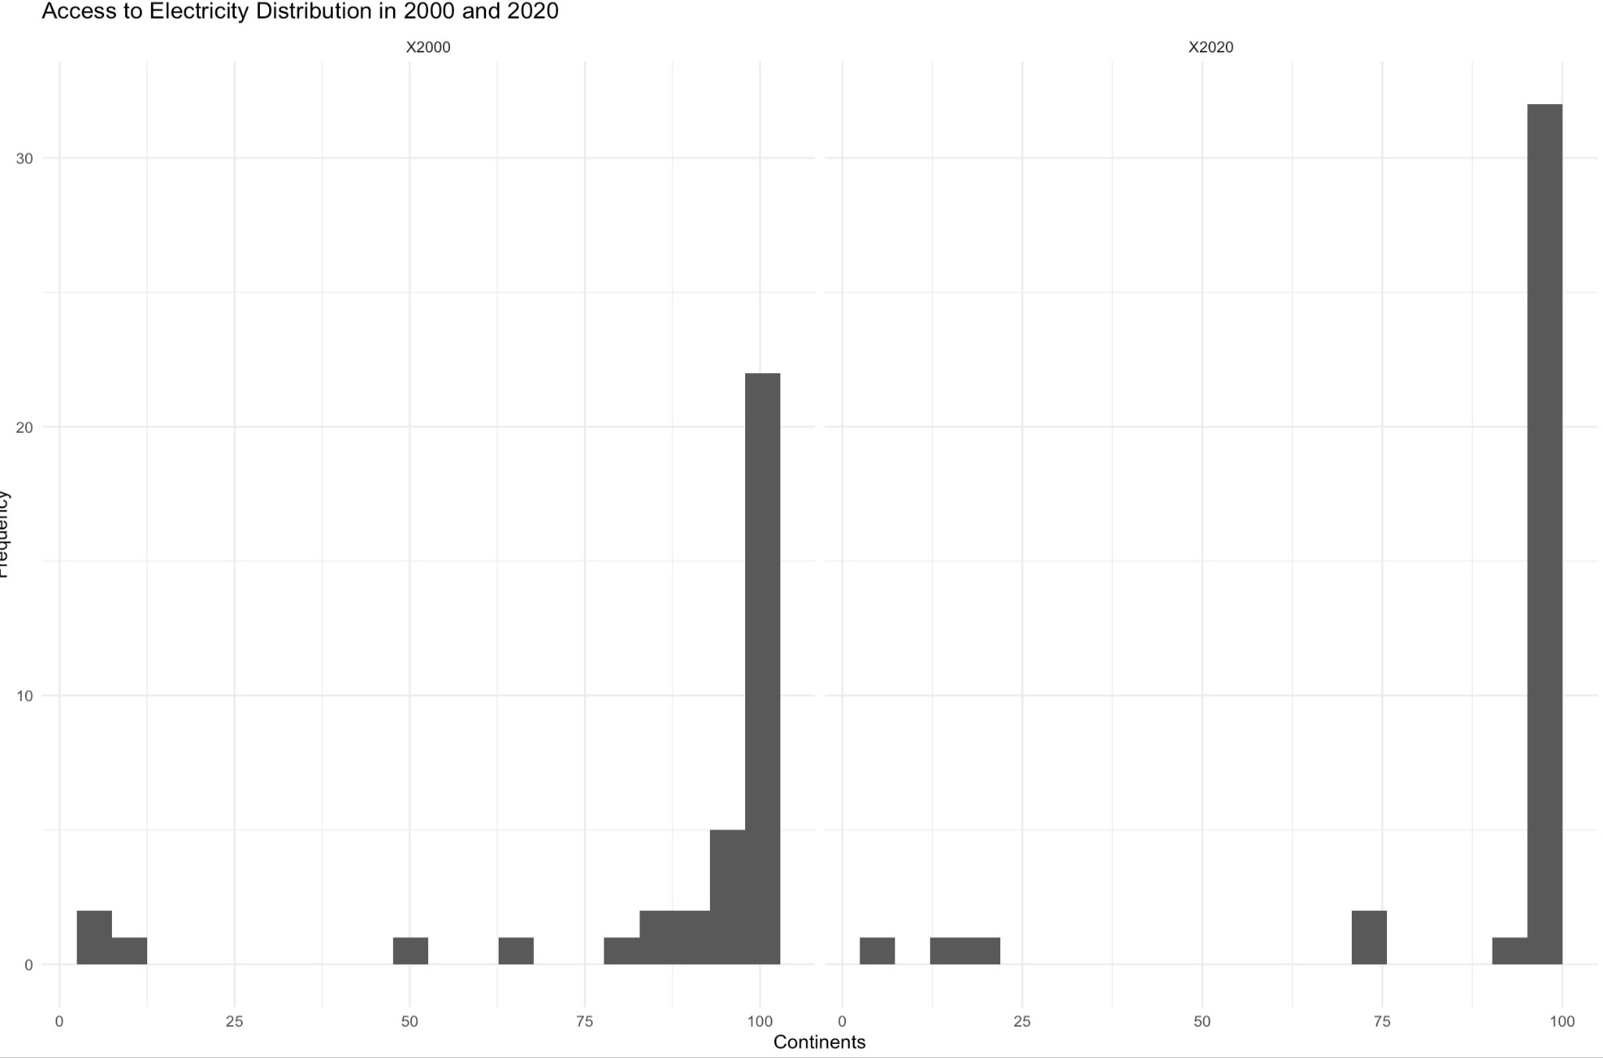

Slide 7
